Slide 1


Chapter Twelve
Discrimination and Male-Female Earnings Differentials
Prepared by Dr. Mir Ahasan Kabir
York University

Slide 2
Learning Objectives
Describe the factors that give rise to the male-female pay gap (or any pay gap for minority groups) and, especially, the importance of discrimination in explaining that gap.
Outline the methodologies that have been used to estimate discriminatory pay gaps and the challenges associated with those methods so as to have an appreciation of the difficulties of determining the extent of discrimination.
Explain how discriminatory pay gaps may be sustained in markets even though they can entail inefficient practices by not hiring the best people given their wages.
Discuss the pros and cons of different policy initiatives for combating discrimination.
Explain the factors giving rise to changes in the male female pay gap over time.
Describe the mechanics and complexities of pay equity policy initiatives.
© 2021 MCGRAW-HILL EDUCATION LTD.
12 - <number>

Slide 3
Main Questions
How can otherwise equally productive men and women be paid different wages in a competitive labour market? Will competitive market forces dissipate discrimination?
What methods are used to measure the extent of discrimination in the labour market?
How much discrimination against women exists in the Canadian labour market? Is there evidence of discrimination against other groups?
What policies have been adopted to address the effects of discrimination? Which policies have been effective?
How has the gender pay gap changed over time and why? What is the expectation for the future?
© 2021 MCGRAW-HILL EDUCATION LTD.
12 - <number>

Slide 4
Theories of Labour Market Discrimination and Some Evidence
Groups who have the same productivity or productivity-related characteristics are treated differently purely because of their demographic group or personal characteristics.
Who can discriminate and why?
  Employers: wage, hiring and promotion practise
  Male co-workers: prejudice, misinformation, or job security
  Customers: discriminatory preferences
© 2021 MCGRAW-HILL EDUCATION LTD.
12 - <number>

Slide 5
Theories of Labour Market Discrimination and Some Evidence
Demand Theories
Supply Theories
Noncompetitive Theories
© 2021 MCGRAW-HILL EDUCATION LTD.
12 - <number>

Slide 6
Theories of Labour Market Discrimination and Some Evidence
Demand theories of discrimination:
Demand for female labour is lower than male labour, causing lower employment and lower wages of female labour
Possible causes:
  Underestimation of female productivity
  Statistical and signalling theories of discrimination
© 2021 MCGRAW-HILL EDUCATION LTD.
12 - <number>

Slide 7
Theories of Labour Market Discrimination and Some Evidence
Supply theories of discrimination:
Increased supply of female labour, causing lower productivity and reduced wage rate.
  Crowding hypothesis: Females are segregated into female type jobs and there is an excess supply of female labour, causing lower marginal productivity of female labour and, hence, a lower wage rate.
  Dual labour market: With males in the core and females in the secondary market, the wage in the secondary market is much lower.
© 2021 MCGRAW-HILL EDUCATION LTD.
12 - <number>

Slide 8
Theories of Labour Market Discrimination and Some Evidence
Noncompetitive theories of discrimination:
    Cost of Adjustment and Imperfect Information
    Fixed costs associated with recruiting and hiring
© 2021 MCGRAW-HILL EDUCATION LTD.
12 - <number>

Slide 9
Theories of Labour Market Discrimination and Some Evidence
Queuing theories:
Firms are paying efficiency wages higher than competitive wages in order to:
    Reduce turnover
    Improve morale
    Have the advantage of a queue of workers that are waiting to be hired anytime
© 2021 MCGRAW-HILL EDUCATION LTD.
12 - <number>

Slide 10
Theories of Labour Market Discrimination and Some Evidence
Productivity Differences: Choice or Discrimination?
Women differ from men in their acquired capital endowment due to:
  Shorter expected length of labour market participation which, in turn, reduces their level of experience
  Higher turnover rate
  Higher absenteeism
  Difference in household responsibilities
© 2021 MCGRAW-HILL EDUCATION LTD.
12 - <number>

Slide 11
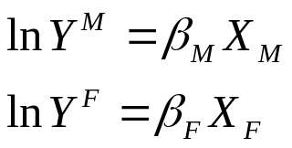

Measuring Discrimination
Oaxaca Decomposition
Male-female wage differentials: Y^{F}/Y^{M}
Use human capital earning functions:
Take log to the male-female wage ratio
Adding and substrating β_{F}X_{F}
Pre-market
Characteristics
Discriminations
© 2021 MCGRAW-HILL EDUCATION LTD.
12 - <number>

Slide 12
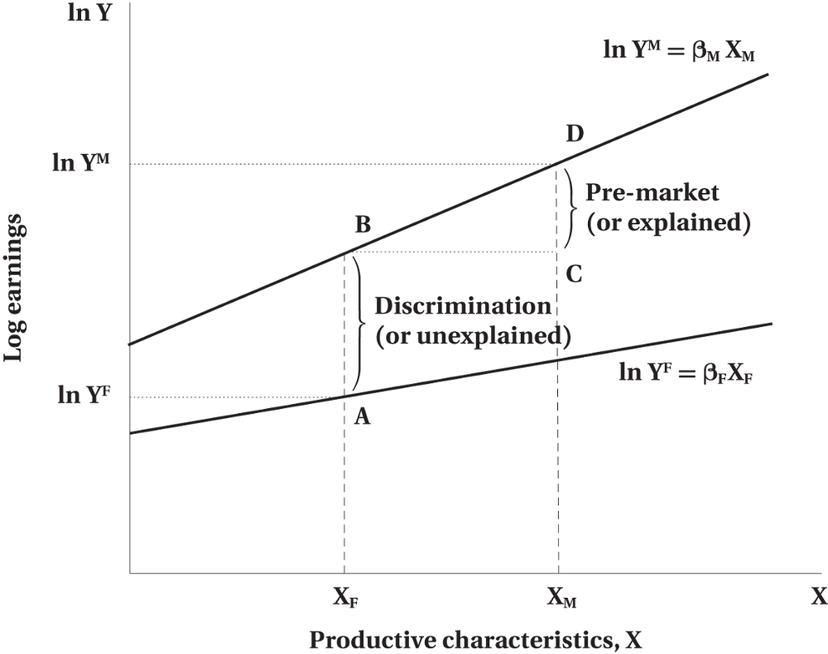
Measuring Discrimination
Figure 12.1 Graphical Illustration of the Oaxaca Decomposition
© 2021 MCGRAW-HILL EDUCATION LTD.
12 - <number>

Slide 13

Measuring Discrimination
WORKED EXAMPLE
Analyzing the Determinants of Male and Female Earnings
What do these coefficients imply about the differential effect of education, experience, marital status, and the presence of children on the wages of males and females?
© 2021 MCGRAW-HILL EDUCATION LTD.
12 - <number>

Slide 14
Measuring Discrimination
WORKED EXAMPLE
Analyzing the Determinants of Male and Female Earnings
Based on these coefficients and the mean values of the explanatory variables, calculate the expected ln wages for both males and females.
E(LnW_{m}) = .40 + .07 ( 14 ) + .06 ( 10 ) + .05 ( .5 ) + .01 ( .6 ) = 2.01
E(LnW_{f} ) = .01 + .10 ( 15 ) + .04 ( 7 ) − .02 ( .5 ) − .05 ( .6 ) = 1.75
© 2021 MCGRAW-HILL EDUCATION LTD.
12 - <number>

Slide 15
Measuring Discrimination
WORKED EXAMPLE
Analyzing the Determinants of Male and Female Earnings
What is the average total or “raw” ratio of female to male ln wages?
E (Ln W_{f})/E(Ln W_{m}) = WA_{f}/WA_{m} = 1.75/2.01 = .87
© 2021 MCGRAW-HILL EDUCATION LTD.
12 - <number>

Slide 16
Measuring Discrimination
WORKED EXAMPLE
Analyzing the Determinants of Male and Female Earnings
Calculate the expected ln wages for an average female, assuming she was paid according to the same pay structure as the average male.
ln ⁡W_{f} * = .40 + .07 ( 15 ) + .06 ( 7 ) + .05 ( .5 ) + .01 ( .6 ) = 1.90
© 2021 MCGRAW-HILL EDUCATION LTD.
12 - <number>

Slide 17
Measuring Discrimination
WORKED EXAMPLE
Analyzing the Determinants of Male and Female Earnings
Calculate the expected ln wage for an average male, assuming he was paid according to the same pay structure as the average female.
ln ⁡W_{m}* = .01 + .10 ( 14 ) + .04 ( 10 ) − .02 ( .5 ) − .05 ( .6 ) = 1.77
© 2021 MCGRAW-HILL EDUCATION LTD.
12 - <number>

Slide 18
Measuring Discrimination
WORKED EXAMPLE
Analyzing the Determinants of Male and Female Earnings
What is the hypothetical difference in ln wages if females were paid according to the male pay structure?
ln ⁡W_{f}* - E(LnW_{m} ) = 1.90 - 2.01 = -. 11
What is the hypothetical difference in ln wages if males were paid according to the female pay structure?
E (LnW_{f}) - LnW_{m}* = 1.75 - 1.77 = - 0 .02
© 2021 MCGRAW-HILL EDUCATION LTD.
12 - <number>

Slide 19
Additional Evidence on Male–Female Pay Differentials
Different studies have focused on different aspects of discrimination such as:
  Wage discrimination
  Sex discrimination
  Institutional discrimination
  Household discrimination
Findings:
  While the results are varied, on average females tend to earn about 60 to 65 percent of what males earn in part due to invisible barriers (glass ceilings) in the labour market.
© 2021 MCGRAW-HILL EDUCATION LTD.
12 - <number>

Slide 20
Additional Evidence on Male–Female Pay Differentials
Indirect evidence of discrimination as reflected in unequal pay between the groups
The question is: “What would women earn if they were men”?
By holding all productive characteristics constant and changing the sex only, one can see how the pay would be adjusted.
Discrimination occurs when equally qualified women and men are paid differently, performing the same job in the same firm.
© 2021 MCGRAW-HILL EDUCATION LTD.
12 - <number>

Slide 21
Additional Evidence on Male–Female Pay Differentials
The results of empirical studies on gender discrimination conclude that on average the wage gaps exist due to:
  Household responsibilities
  Family responsibilities
  Occupational distribution of females into lower paid industries
  Employment of women into low paid occupations
© 2021 MCGRAW-HILL EDUCATION LTD.
12 - <number>

Slide 22
Empirical Evidence for Other Groups
Table 12.1 Ethnic Wage Differentials, Various Groups Born in Canada or United States Table Summary: The table has five columns with headers in rows one, two, and five. In rows two and five, columns two to five are blank.
Black | South Asianª | Southeast Asian^{b} | Chinese | Aboriginal
Canada
Total gap 0.293 | 0.536 | −0.022 | 0.193 | 0.179
“Discrimination” 0.171 | 0.222 | 0.023 | 0.058 | 0.091
United States
Total gap 0.328 | 0.176 | −0.079 | −0.205 | 0.304
“Discrimination” 0.123 | 0.055 | −0.007 | −0.047 | 0.136
© 2021 MCGRAW-HILL EDUCATION LTD.
12 - <number>

Slide 23
Policies to Combat Sex Discrimination
Conventional Equal Pay
  Deals only with wage discrimination within the same job within the same establishment
Equal Value, Pay Equity, or Comparable Worth
  Value procedures an important component
Equal Employment Opportunity
  May benefit new recruits
Affirmative Action/Employment Equity
Facilitating Policies
© 2021 MCGRAW-HILL EDUCATION LTD.
12 - <number>

Slide 24
Policies to Combat Sex Discrimination
Equal pay legislation
  Requires equal pay for equal value of work within the same establishment
  The value is determined by a job evaluation scheme that is free of gender bias
  Applicable in all Canadian jurisdictions except Alberta
© 2021 MCGRAW-HILL EDUCATION LTD.
12 - <number>

Slide 25
Policies to Combat Sex Discrimination
Equal Value, Pay Equity, or Comparable Worth
  Equality of pay between jobs of equal value
  Value determined by job evaluation scheme free of gender bias
  Comparisons between jobs that are predominantly male and predominantly female
  Rationale-deals with both wage discrimination and occupational segregation
© 2021 MCGRAW-HILL EDUCATION LTD.
12 - <number>

Slide 26
Policies to Combat Sex Discrimination
Scope of equal value initiatives:
  Potentially large because it allows comparison across occupations
  Limited sometimes because of the fear of the employees to complain
  Enables employees to achieve pay equity through job evaluation system
© 2021 MCGRAW-HILL EDUCATION LTD.
12 - <number>

Slide 27
Policies to Combat Sex Discrimination
Design Features of Comparable Worth
The following features will have to be designed and worked out to facilitate the practical implementation of the policy
Definition of gender predominance
Job evaluation procedure
Procedure for adjusting payment
Exemptions
© 2021 MCGRAW-HILL EDUCATION LTD.
12 - <number>

Slide 28
Policies to Combat Sex Discrimination
Equal Employment Opportunity Legislation
  Designed to prevent discrimination in recruiting, hiring, and promotion
  Time consuming since it involves a few stages in filling in the complaint, court decision, and investigation
  Increases female employment
  Increases female wages
  Serves as a complement to equal pay legislation
© 2021 MCGRAW-HILL EDUCATION LTD.
12 - <number>

Slide 29
Policies to Combat Sex Discrimination
Affirmative Action/Employment Equity Legislation
  Exists only in federal jurisdiction
  Covers only 10% of the Canadian labour force
  Applicable to four designated groups: women, visible minorities, disabled persons, and Aboriginal people
Policies to Facilitate Female Employment
  Designed to expand the range of choices for women
  Increase female participation in the labour market
  Improves availability of facilities and family-friendly workplaces practices
© 2021 MCGRAW-HILL EDUCATION LTD.
12 - <number>

Slide 30
Policies to Combat Sex Discrimination
Overall impact of Policy Initiatives:
  Limited impact and scope
  The effect of equal pay and equal employment opportunity policies is inconclusive
  Comparable worth policies have reduced the earning gap
© 2021 MCGRAW-HILL EDUCATION LTD.
12 - <number>

Slide 31
Chapter Summary
Definition, causes, and consequences of discrimination
Theories of discrimination: demand, supply, noncompetitive, and queuing theories
Empirical evaluation and research
Policy categories to combat discrimination, their scope, impact, and design
© 2021 MCGRAW-HILL EDUCATION LTD.
12 - <number>

